Slide 1
Definitions
Coin
A piece of metal (or, rarely, of some other material) certified by a mark or marks upon it to be of a definite exchange value, and issued by governmental authority to be used as money; also, such pieces collectively.
Money
It is a means of exchange if people make payments for goods and services; it is a means of payment, if people pay taxes, rents and penalties; it is a store of value, if people keep it in a treasure box, display it at home, or put it in a bank account; and it is a unit of account, if people compare the value of different goods on the basis of that medium, or account for debts, future payments, and so on.

Slide 2
Terms
Obverse
The ‘front’ side of a coin, usually featuring a head
Reverse
The ‘back’ side of a coin
Legend
An inscription on a coin
Denomination
The value of a coin

Slide 3
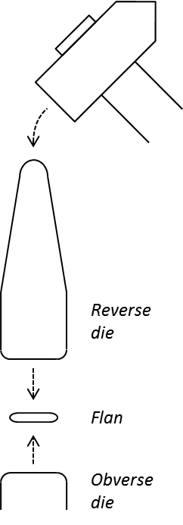
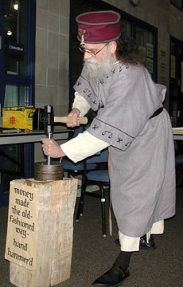
Coin Production

Slide 4
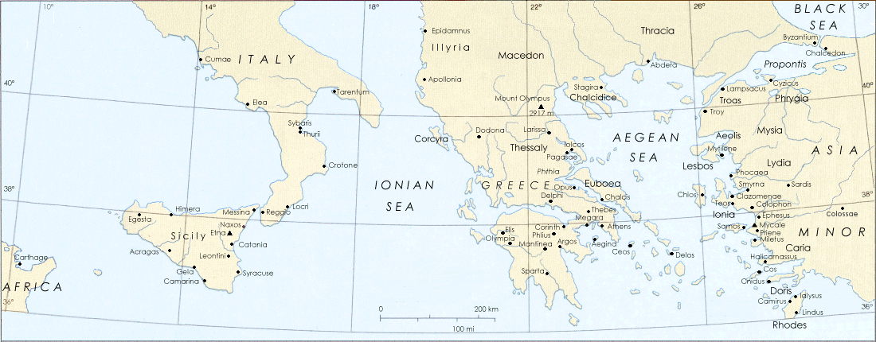
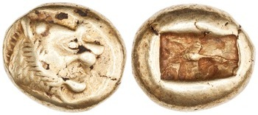
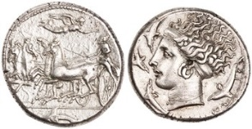
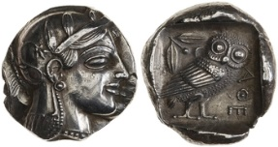
The Invention of Coinage

Slide 5
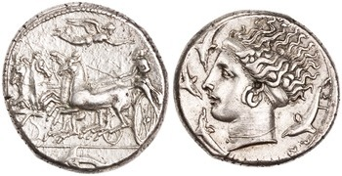
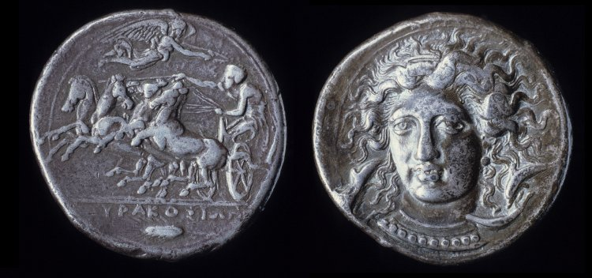
Syracuse
Silver tetradrachm, Syracuse, Sicily, c. 405-395 BCE; obv.: quadriga l., Nike flying r. crowning charioteer, dolphin below; rev.: Arethusa head l., four dolphins around, legend: ΣYPAKOΣIΩN
Silver tetradrachm, Syracuse, Sicily, c. 405-395 BCE; obv.: quadriga l., Nike flying r. crowning charioteer, dolphin below; legend: ΣYPAKOΣIΩN; rev.: Arethusa head ¾ l., two dolphins; legend: KIMON

Slide 6
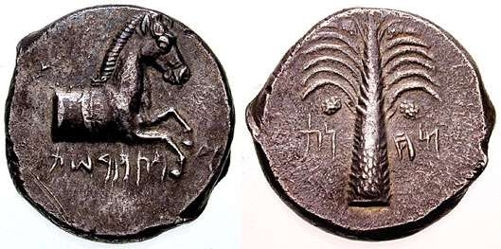
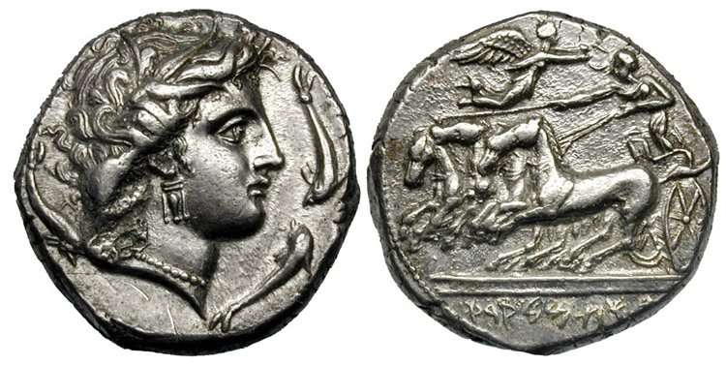
Punic Sicily
Silver tetradrachm, Syracuse, Sicily, c. 410-395 BCE; obv.: quadriga l., Forepart of a bridled horse right; legend (in Punic): CARTHAGE; rev.: palm tree with two date clusters; legend (in Punic): THE CAMP
Silver tetradrachm, Rash Melqart, Sicily, c. 350-300 BCE; obv.: Arethusa head r., four dolphins around; rev.: quadriga l., Nike flying r. crowning charioteer; legend (in Punic): RASH MELQART

Slide 7
The Twelve Tables (c. 450 bce)
Table 2, Law 9: “Where anyone secretly cuts down trees belonging to another, he shall pay twenty-five asses for each tree cut down.”
Table 3, Law 2: “When anyone collects interest on money loaned at a higher rate per annum than that of the unciæ (i.e., ~10%), he shall pay quadruple the amount by way of penalty.”
Table 7, Law 10: “When anyone knocks a tooth out of the gum of a freeman, he shall be fined three hundred asses; if he knocks one out of the gum of a slave, he shall be fined a hundred and fifty asses.”

Slide 8
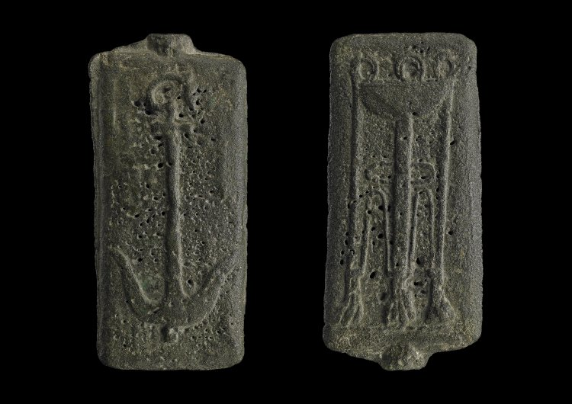
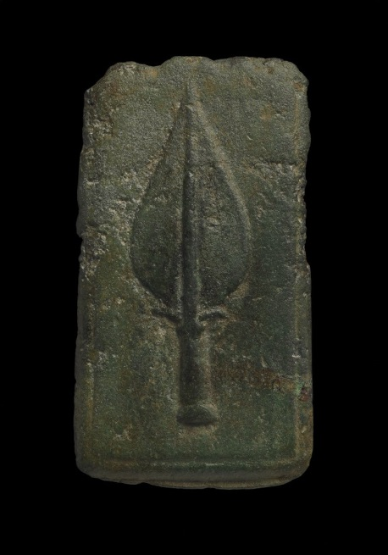
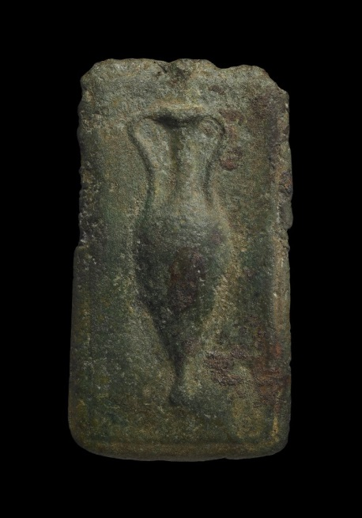
Aes Signatum
Bronze ingot, Rome, Italy, c. 280-250 BCE; obv.: anchor; rev.: tripod
Bronze ingot, Rome, Italy, c. 280-250 BCE; obv.: spearhead; rev.: amphora

Slide 9
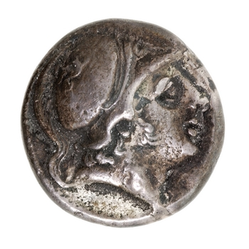
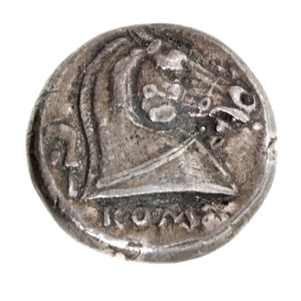
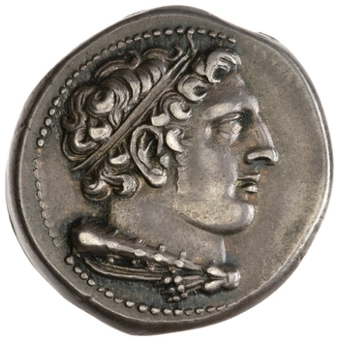
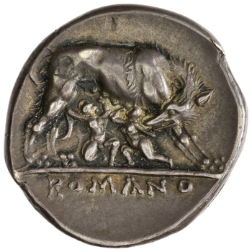
Early Roman Silver
Silver didrachm, Rome, Italy, c. 269-266 BCE; obv.: head of Hercules r.; rev.: she-wolf r., suckling twins; legend: ROMANO
Silver didrachm, Rome, Italy, c. 241-235 BCE; obv.: head of Mars r., wearing Corinthian helmet; rev.: horse’s head r.; legend: ROMA

Slide 10
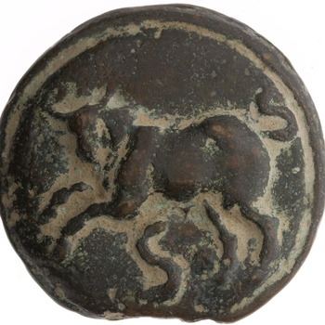
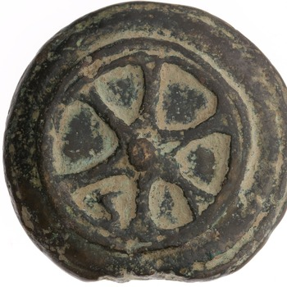
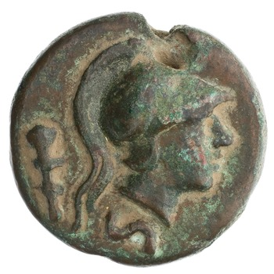
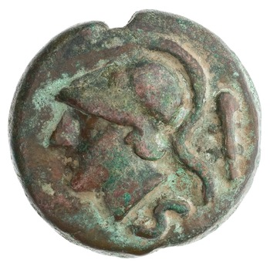
Aes Grave (~136 g)
Bronze semis, Rome, Italy, c. 265-242 BCE; obv.: bull l., denomination mark S below; rev.: wheel with six spokes, denomination mark S
Bronze semis, Rome, Italy, c. 230-226 BCE; obv.: head of Minerva r., wearing Corinthian helmet, club behind, denomination mark S below; rev.: head of Minerva l., wearing Corinthian helmet, club behind, denomination mark S below

Slide 11
The Denarius
Plural denarii
From Latin deni, meaning ‘having ten,’ because it originally equaled 10 asses
Many etymological descendants:
Currencies: dinar (common currency in Arab and Slavic countries), denar (Macedonia), denier (old French coin)
Words for money: denaro (Italian), dinero (Spanish), dinheiro (Portuguese), denar (Slovene), diner (Catalan)
‘Penny’ may even derive from Latin deni

Slide 12
Chronology
Early denarii found in the destruction layers at Morgantina on Sicily, datable by historical references to 211 BCE
Some Carthaginian coins minted during the invasion of Sicily in 213-211 BCE were struck over denarii
Quadrigati, the latest pre-denarius Roman coin, occurs in Sicilian hoards with Sicilian coins dating to 216-212 BCE

Slide 13
Second Punic War (218-201 bce)
Hannibal
Cornelius Scipio, Sr.
Tiberius Sempronius

Slide 14
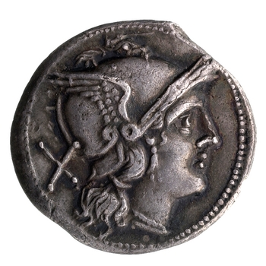
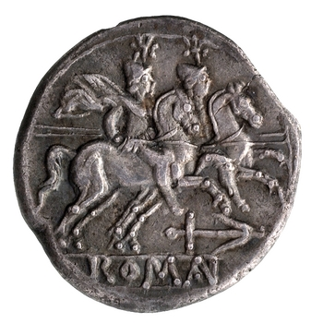
The Denarius
*
Silver denarius, Rome, Italy, c. 209-208 BCE; obv.: helmeted head of Roma r., denomination mark X behind; rev.: Dioscuri galloping r., mint mark below; legend: ROMA

Slide 15
Denominations
Denomination | Value mark | Value in asses | Types
Denarius | X | 10 | Roma/Dioscuri
Victoriatus | none | 6.66 | Jupiter/Victory
Quinarius | V | 5 | Roma/Dioscuri
Sestertius | IIS | 2.5 | Roma/Dioscuri

Slide 16
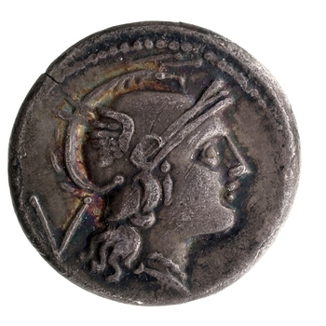
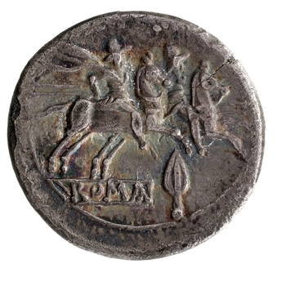
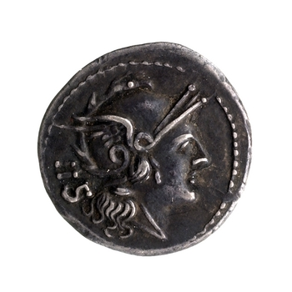
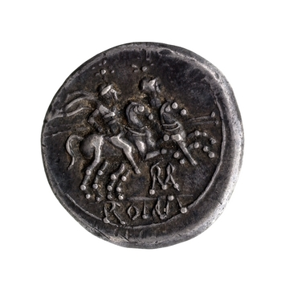
Silver Fractions
Silver quinarius, Rome, Italy, c. 211-210 BCE; obv.: helmeted head of Roma r., denomination mark V behind; rev.: Dioscuri galloping r., mint mark below; legend: ROMA
Silver sesterius, Rome, Italy, c. 211-210 BCE; obv.: helmeted head of Roma r., denomination mark IIS behind; rev.: Dioscuri galloping r., mint mark below; legend: ROMA

Slide 17
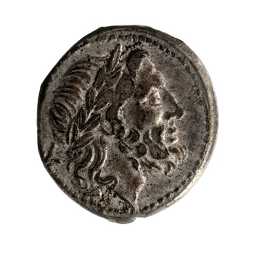
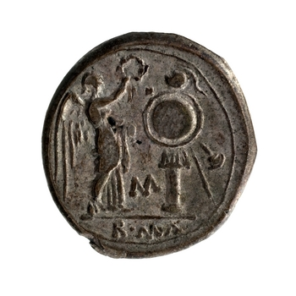
The Victoriatus
Silver victoriatus, Rome, Italy, c. 211-210 BCE; obv.: laureate head of Jupiter r.; rev.: Victory standing r., crowning a trophy, mint mark below; legend: ROMA

Slide 18
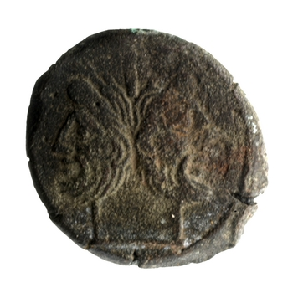
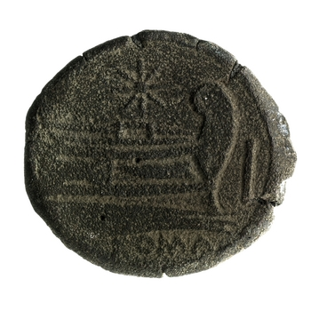
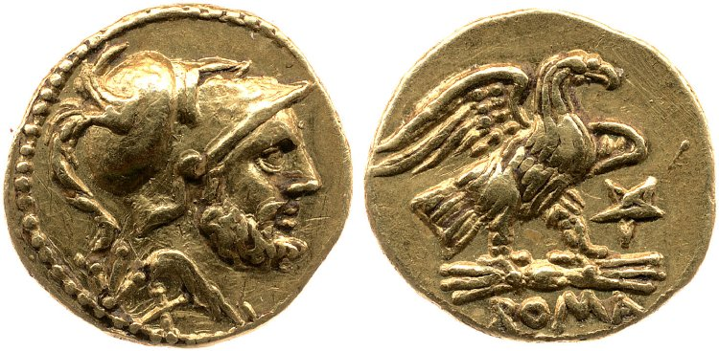
Gold and Bronze Issues
Gold aureus, Rome, Italy, c. 209 BCE; obv.: helmeted head of Mars r., denomination mark X below; rev.: eagle standing r., clutching lightning bolt; mint mark front; legend: ROMA
Bronze as, Rome, Italy, c. 169-158 BCE; obv.: laureate head of Janus; rev.: ship prow r.; legend: ROMA

Slide 19
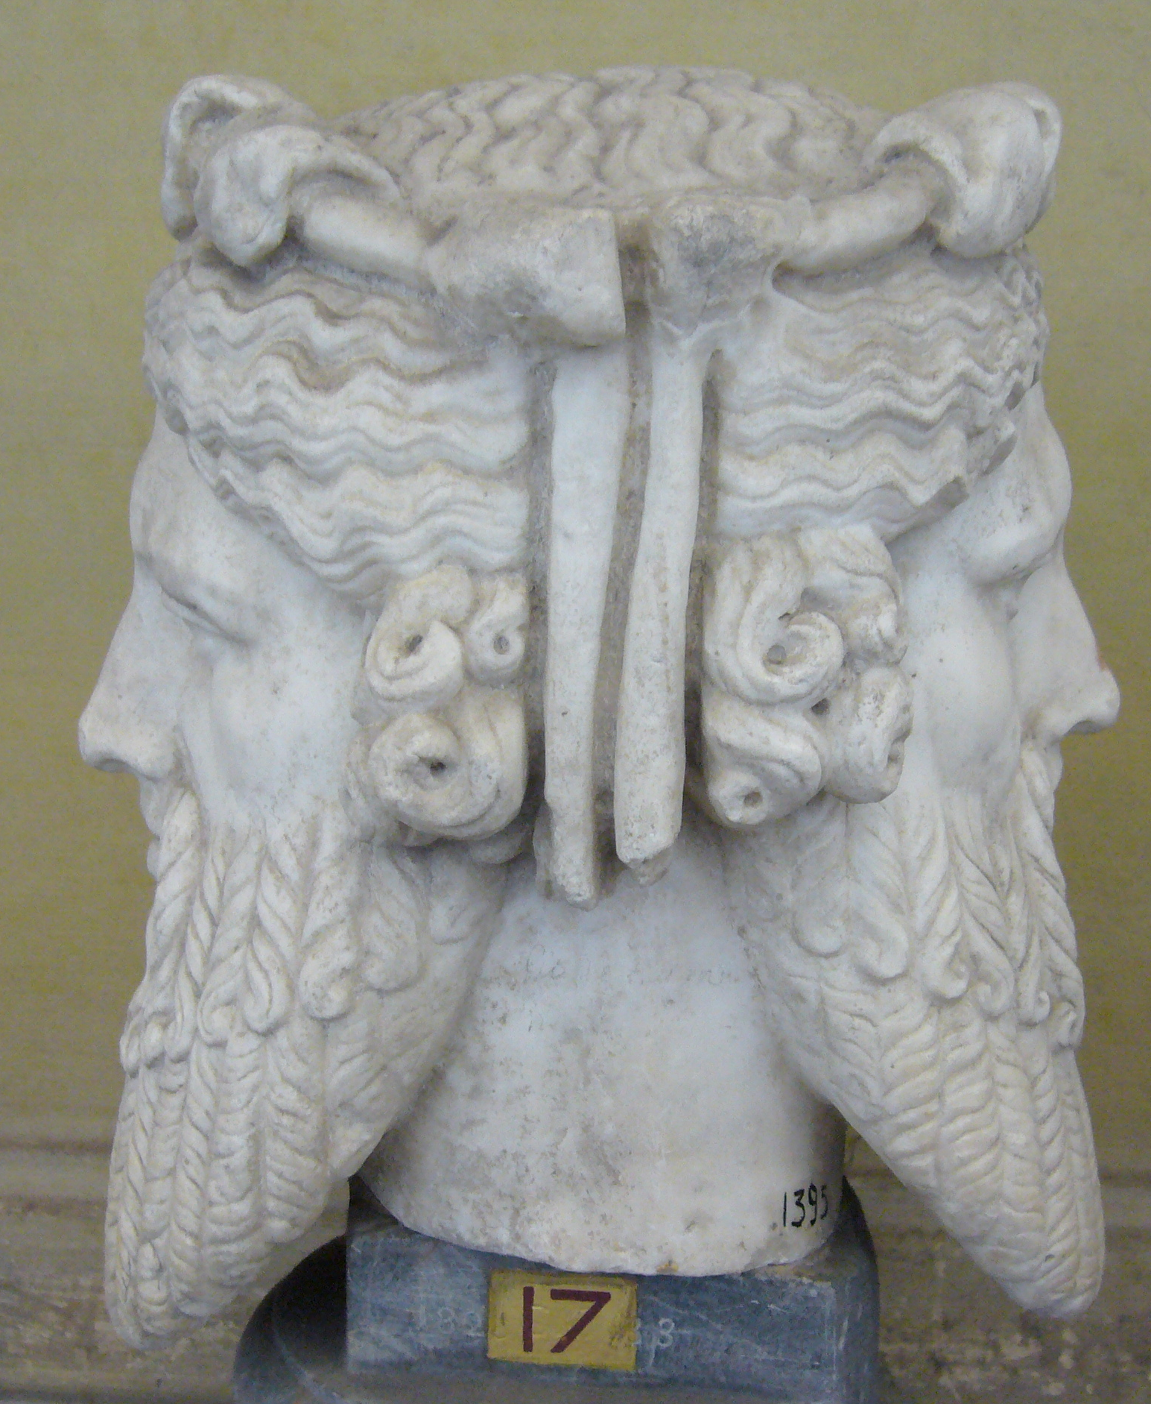
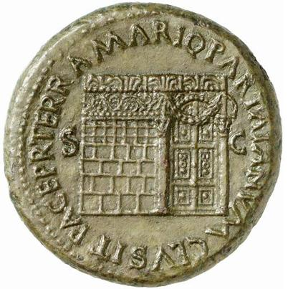
Janus

Slide 20
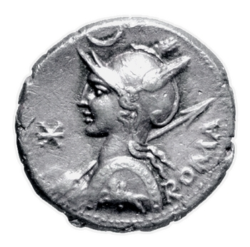
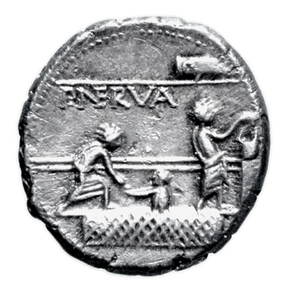
Re-Tariffered Denarius (c. 141 BCE)
*
= XVI
Silver denarius, Rome, Italy, c. 113-112 BCE; obv.: helmeted head of Roma l., denomination mark crossed X front, crescent above; legend: ROMA; rev.: balloting scene; legend: P. NERVA

Slide 21
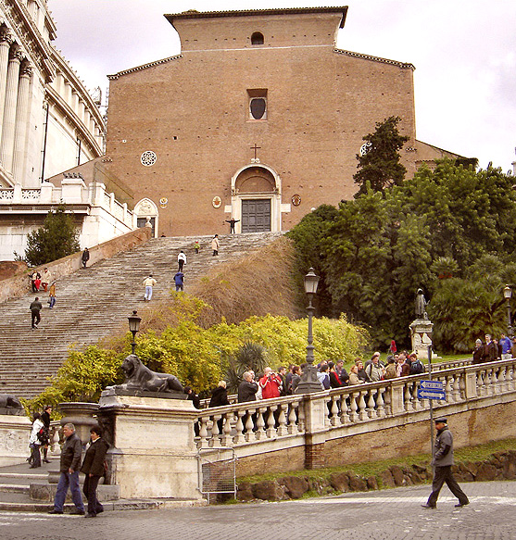
Mint Organization
Minting overseen by IIIviri monetales (‘three money men’)
Became the IVviri monetales (‘four money men’) in 44 BCE
Minting took place at or near the Temple of Juno Moneta at the citadel of the Capitoline Hill
Hence ‘money’

Slide 22
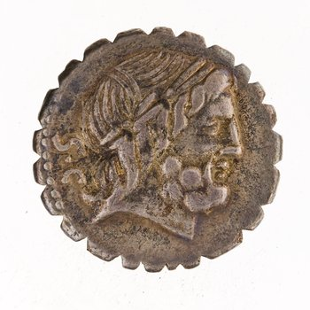
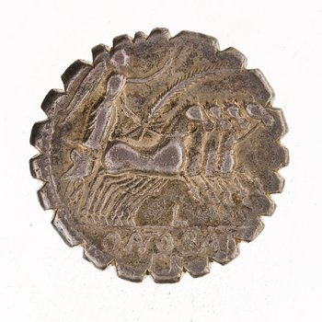
Moneyers
SC = Senatus consulto
Q ANT BALB PR = Quintus Antonius Balbus, praetor
*
Silver denarius, Rome, Italy, c. 113-112 BCE; obv.: helmeted head of Roma l., denomination mark crossed X front, crescent above; legend: ROMA; rev.: balloting scene; legend: P. NERVA
Silver denarius, Rome, Italy, c. 83-82 BCE; obv.: laureate head of Jupiter r.,; legend: SC; rev.: Victory in quadriga r.; legend: Q ANT[onius] BALB[us] PR

Slide 23
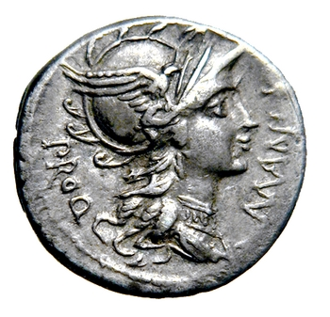
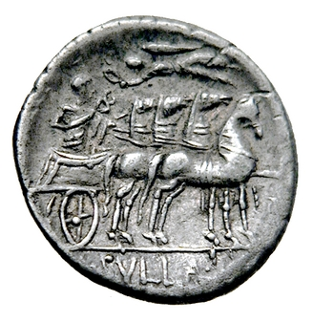
Sulla
Silver denarius, Rome, Italy, c. 82 BCE; obv.: helmeted head of Roma r.; legend: L MANLI[ius] PRO Q; rev.: charioteer in quadriga r. crowned by flying Victory holding caduceus; legend: L SVLLA IM[perator]

Slide 24
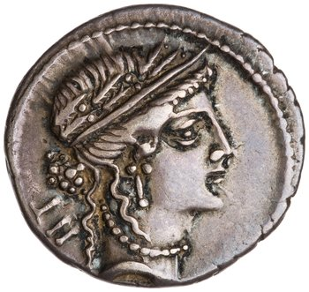
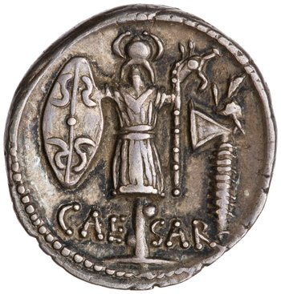
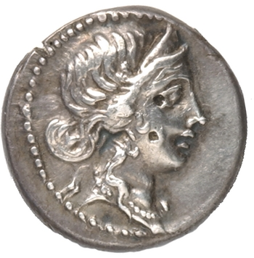
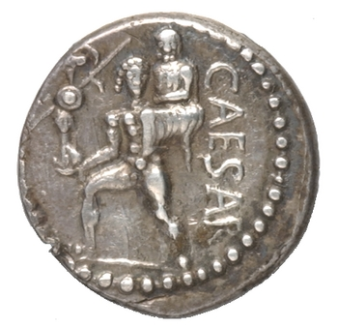
Caesar’s Coins
Silver denarius, Rome, Italy, c. 48-47 BCE; obv.: crowned female head r.; legend: LII; rev.: trophy with Gallic shield, carynx, axe; legend: CAE SAR
AR denarius, Rome, Italy, c. 47-46 BCE; obv.: head of Venus r.; rev.: Aeneas walking l. carrying palladium and Anchises; legend: CAESAR

Slide 25
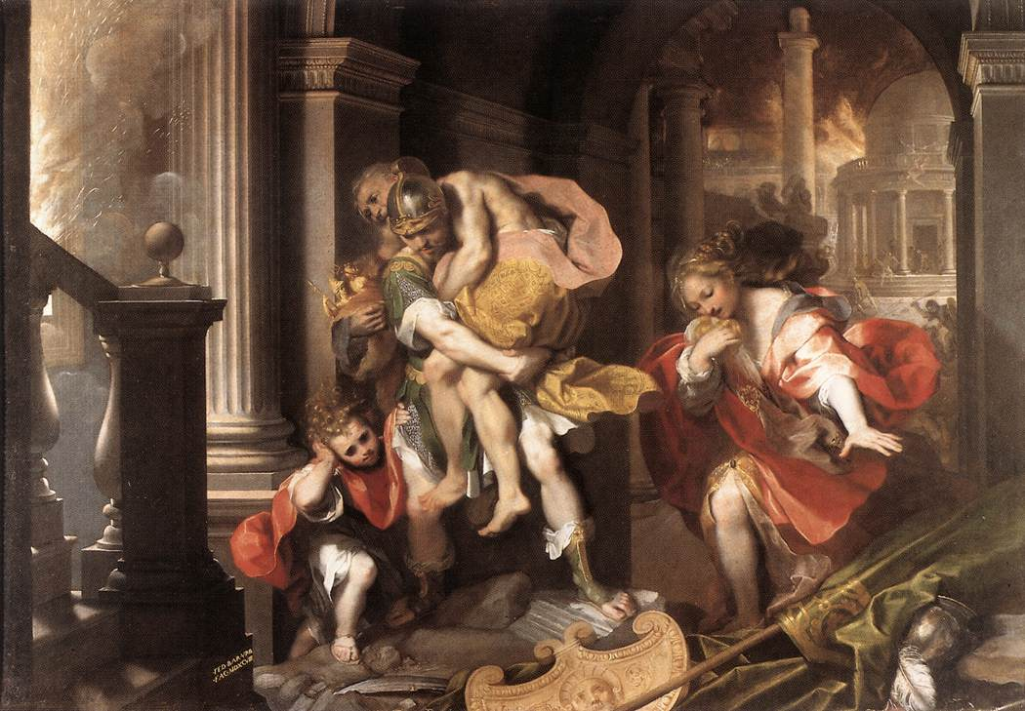
The Fall of Troy

Slide 26
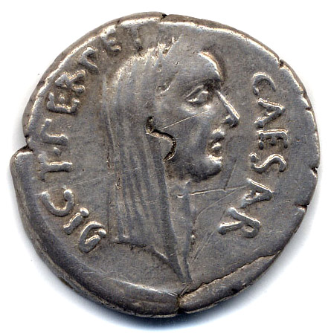
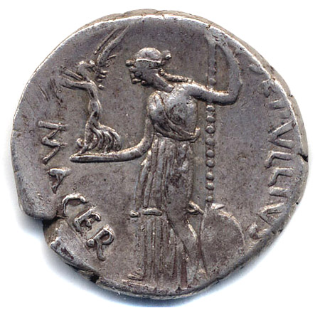
Caesar the Dictator
*
Silver denarius, Rome, Italy, c. 44 BCE; obv.: veiled head of Caesar r.; legend: CAESAR DICT PERPETVO; rev.: Venus standing l. holding scepter and Victory; legend: P SEPVLLIVS MACER

Slide 27
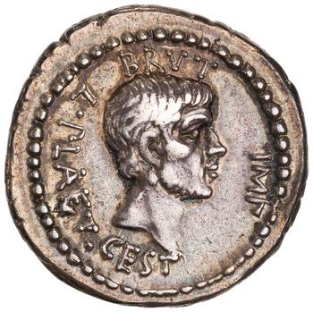
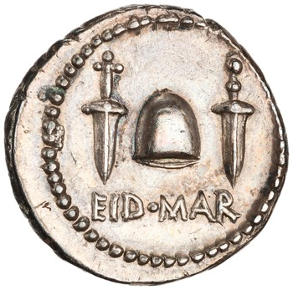
Brutus
*
Silver denarius, Greece(?), c. 43-42 BCE; obv.: head of Brutus r.; legend: BRVT[us] IMP[erator] L. PLAET[us] CEST[us]; rev.: freedman’s cap between daggers; legend: EID MAR (the ides of March)

Slide 28


The Second Triumvirate (44-31 bce)

Slide 29



The Second Triumvirate
Gold aureus, mobile mint, c. 41 BCE; obv.: head of Mark Antony r.; legend: M ANT[ony] IMP[erator] AVG[ustus] III VIR R P C M BARBAT[us] Q P; rev.: head of Octavian r.; legend: CAES[ar] IMP[erator] PONT III VIR R P C
Silver denarius, mobile mint, c. 41 obv.: head of Mark Antony r.; legend: M ANT[ony] IMP[erator] AVG[ustus] III VIR R P C M BARBAT[us] Q P; rev.: head of Octavian r.; legend: CAES[ar] IMP[erator] PONT III VIR R P C

Slide 30




Antony vs. Octavian
*
Silver denarius, Greece or Egypt(?), c. 32 BCE; obv.: head of Mark Antony r.; legend: [Mark] ANTONI ARMENIA DEVICTA (Armenia defeated); rev.: diademed head of Cleopatra r. over prow; legend: CLEOPATRAE REGINAE REGVM FILIORVM REGVM (to the kingdom of Queen Cleopatra and her royal children)
Silver denarius, Rome or Brundisium, Italy c. 31-29 BCE; obv.: head of Octavian l.; rev.: Victory standing r. on a globe holding a wreath and palm; legend: CAESAR DIVI F (son of the god)

Slide 31
Credit
“Damasippus is mad in buying old statues;
the creditor of Damasippus, is he sound of mind? Be it so!
But if I say to you, ‘Take this sum which you need never return to me,’
will you be a madman if you take it? Or will you be more senseless
if you spurn the booty which propitious Mercury offers?”
- Horace, Satires 2.3.64-8

Slide 32
Vocab Review
Denarius
Juno Moneta
Mint
Moneyer
Aes signatum

